Slide 1
Komala Sri P.
Whishing you everything that brings JOY in LIFE
You're not special because it's your birthday – You're special because you're you

Slide 2
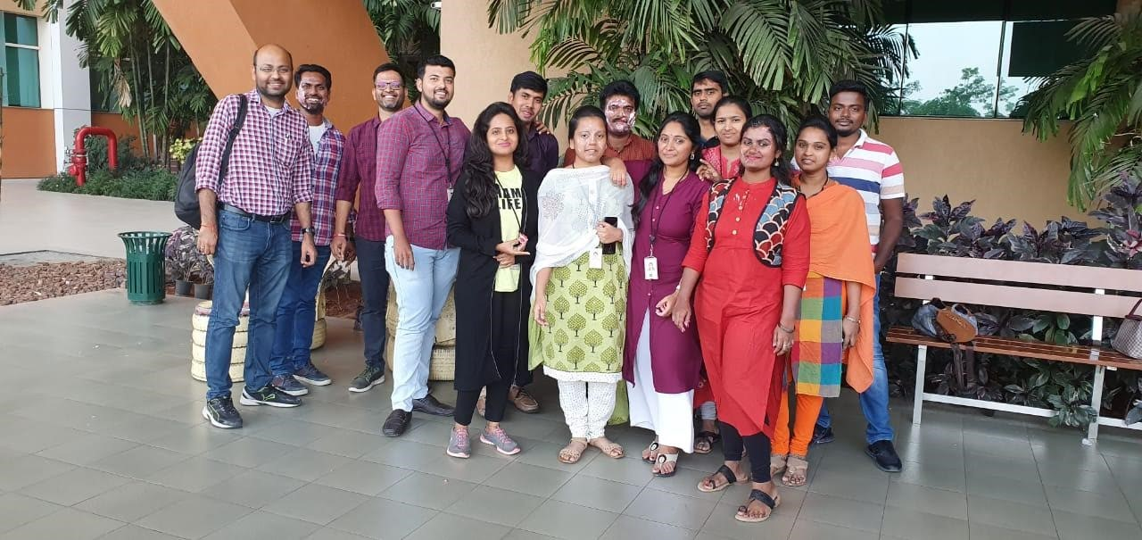
Komala
Dear
Decent
Best friend
Yoke
Understanding
Dear

Slide 3
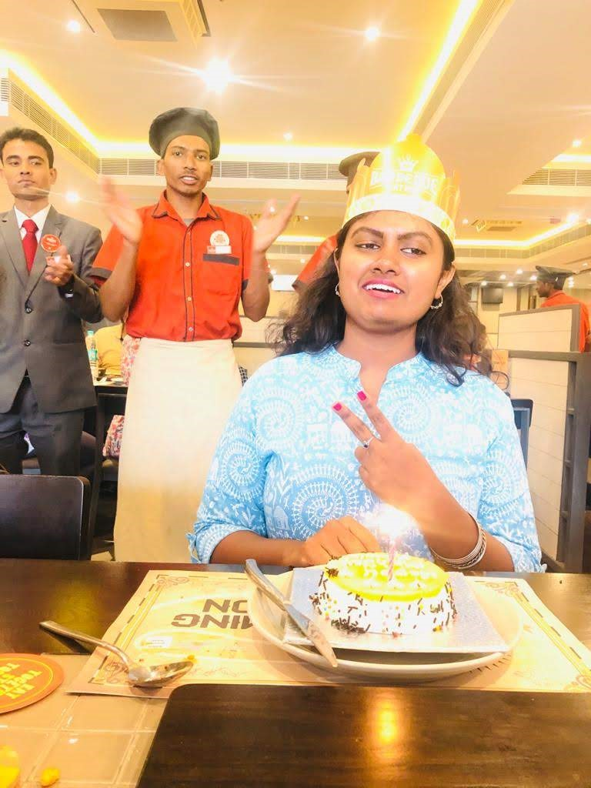
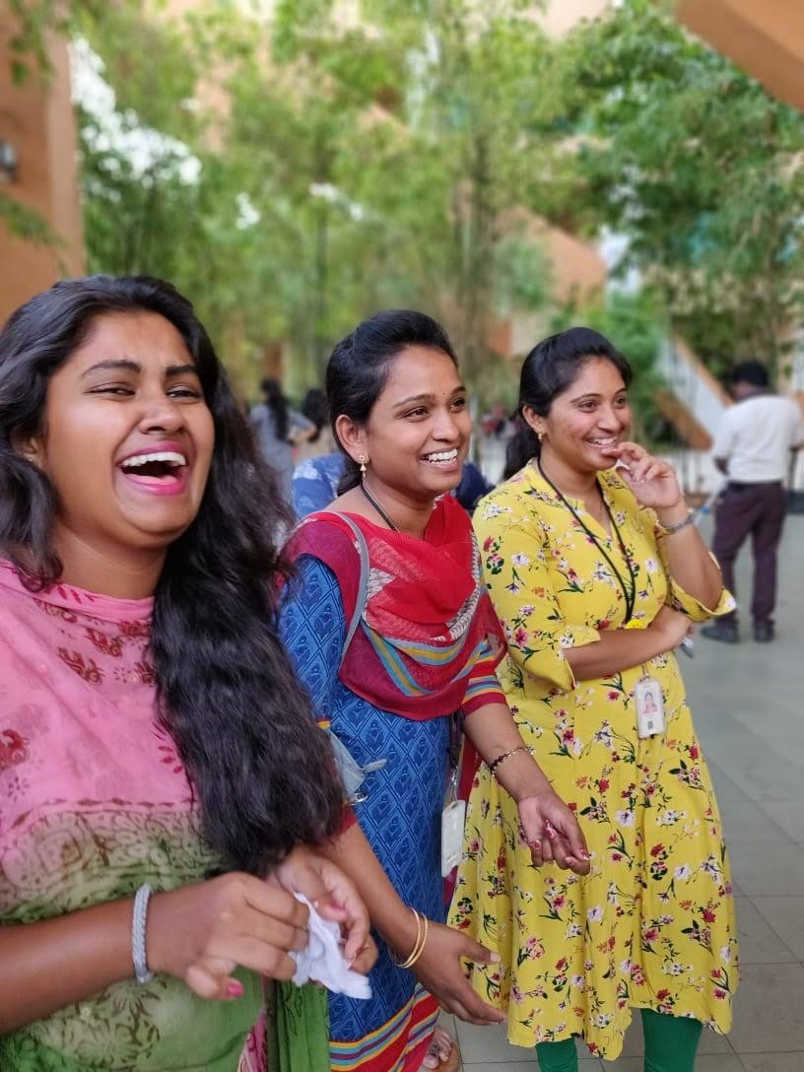
Smile
There are only a few persons when you think of them a little smile will come automatically in your face and Komala is one of them, Keep smiling and make others smile like always you do.
Many more happy returns of the day Komala!!
Smiling
Smile

Slide 4
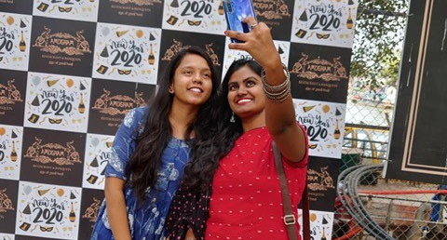
Romantic
Komala is a Beautiful soul and down to earth person​
and
most Romantic also.
Romantic
Beautiful

Slide 5
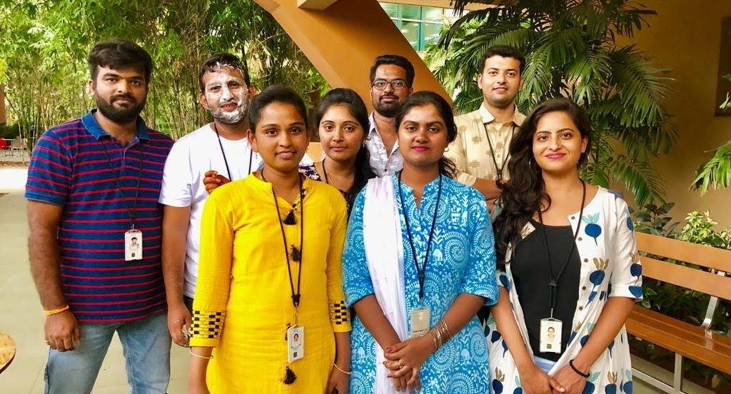
Innocent
Good girl
with innocent nature and super-active, she cares all with a good smile first.
Good Smile

Slide 6
Cheerful
Wish you a happy birthday Komala!
Be cheerful always!
Always
Joyful

Slide 7
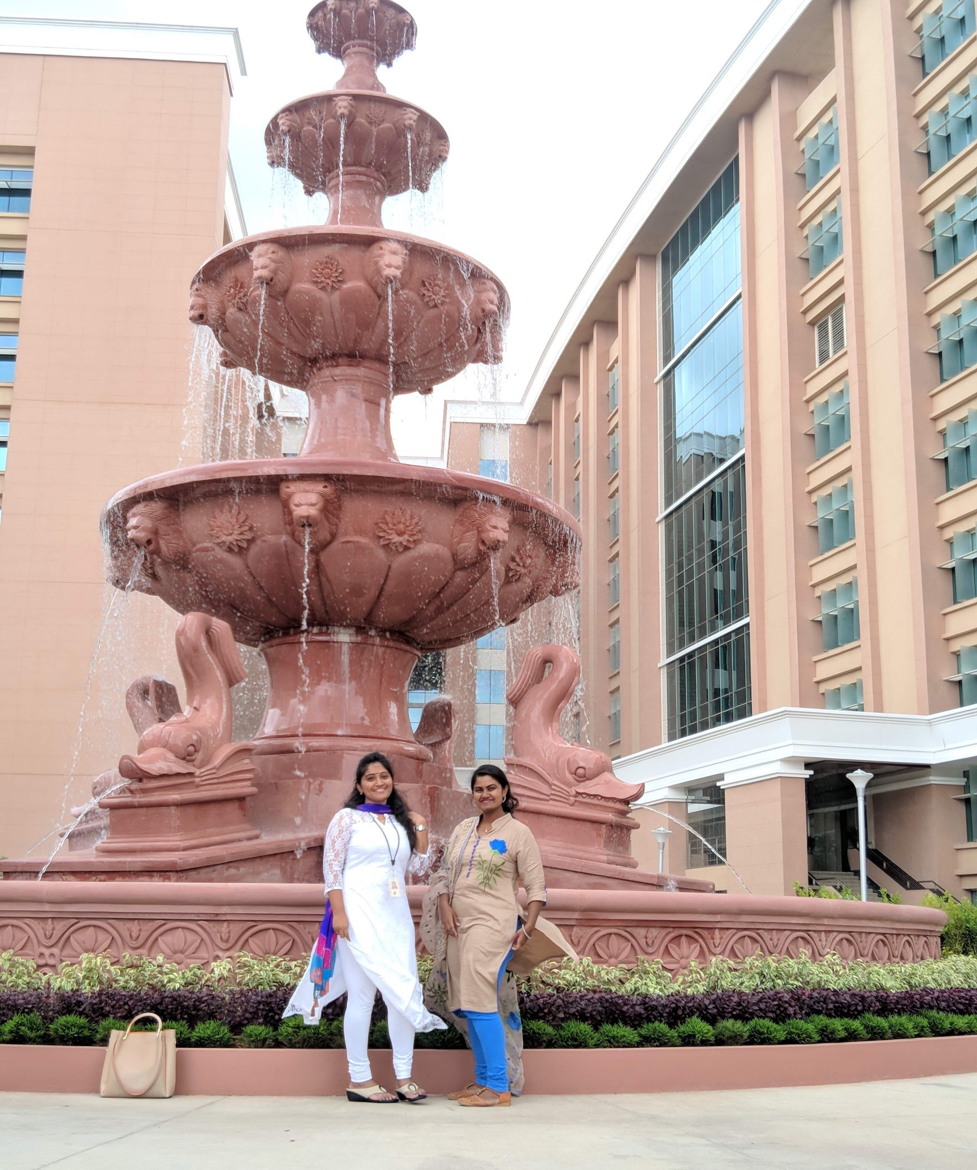
Special
Happy birthday to very best girl in The World!
You are a world-class friend, and I am wishing you a world-class birthday!
I am so lucky to have a best friend like You!
Wishing you a day filled with loveliness, of Everyone's lovely!
Best
Everyone’s Lovely

Slide 8
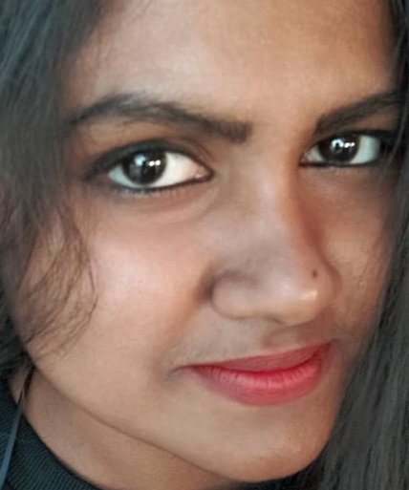
Curiosity
The most Curiosity girl which I have seen.
Yours Dearly
With Curiosity

Slide 9
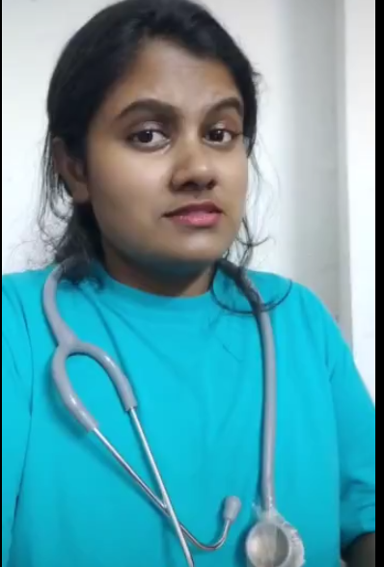
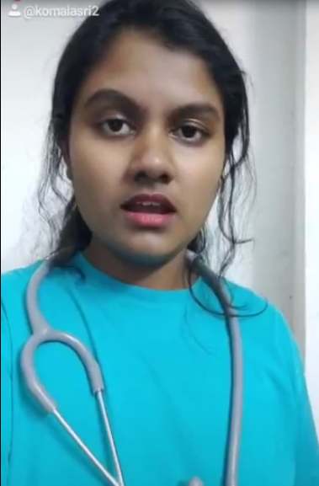
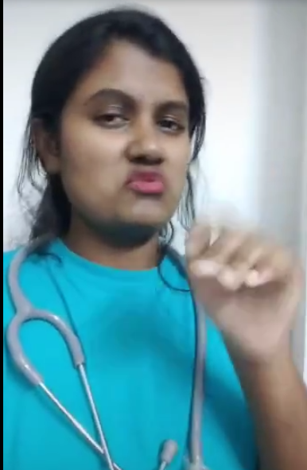
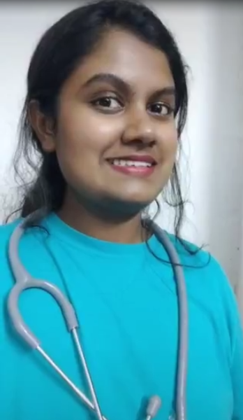
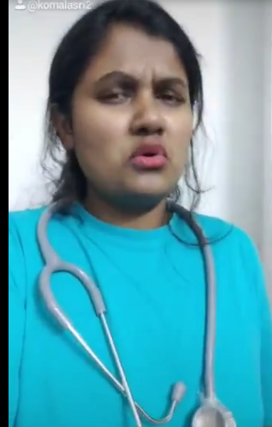
Mega Star
Happy Birthday Megastar!! You are kind , humble , energetic. At least now start learning some cooking and stop taking credit of your mom’s cooking by saying that “you have done it. “

Slide 10
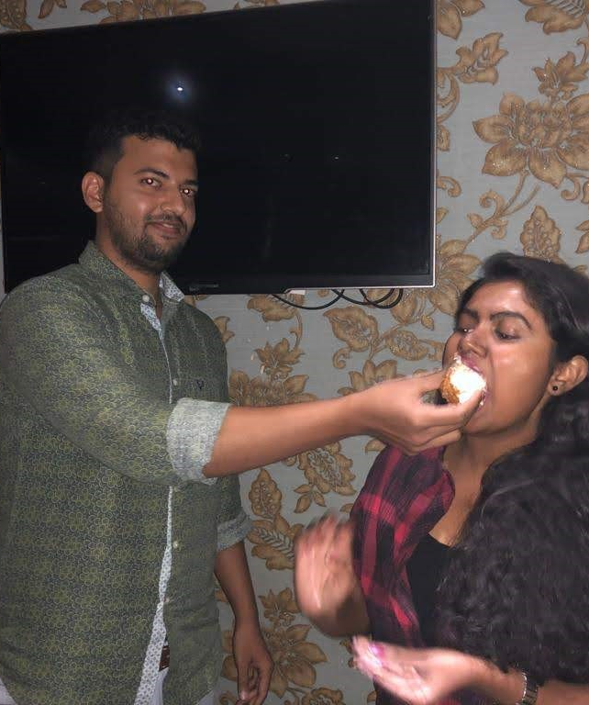
Most Caring
Its a challenge to find the right words for someone who is very special.
Komala is that someone whom you can be yourself with, someone who you can have pointless conversations with.
A very happy birthday to the most caring and the cheerful girl in the team.
Most Caring
Cheerful Girl

Slide 11
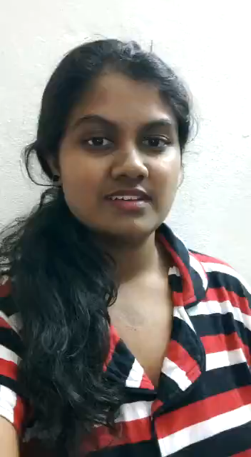
Singer
Your Smile specifies your personality.
Your singing style specifies your talent.
**Essay writer**
**English Teacher**
Writer
Teacher

Slide 12
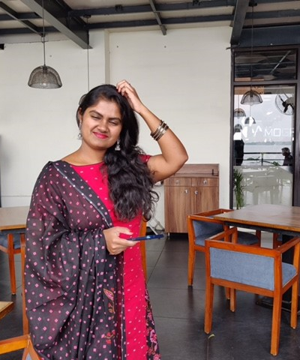
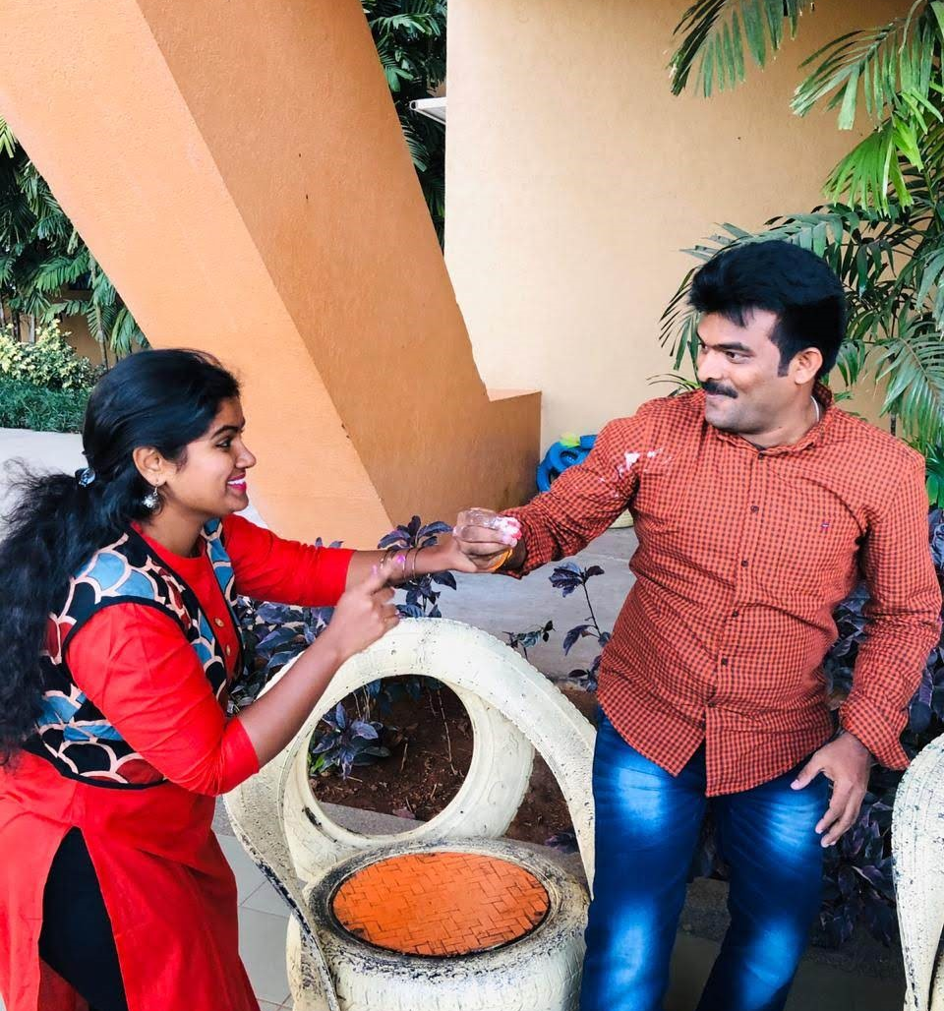
Komala
Humble
Kind
Caring

Slide 13
Sweetest
Komala is the most Sweetest friend of mine. I can even call her my 2am 3 am friend as well 😝 she is always there for me to hear me out and the way she keeps effort(so effortlessly 😝) to check on her friends consistently is something great.
I wish our friendship will grow stronger for many more years and I wish her nothing but all the happiness in the world 😊”.
Friendship
Happiness

Slide 14

Keep Shining!!
Thank you for always being so supportive to everyone. Best things will always attract to you . You are the most amazing person we have ever met. You are someone who dedicates herself to work wholeheartedly.
Wishing you all the happiness to my stunning friend who is blossoming into such a beautiful young woman!
Sending lots of love your way today, gorgeous gal!

